Slide 1
Volunteer Preparedness
IEMS 365: Analytics for Social Good | Team A4
March 9, 2017

Slide 2
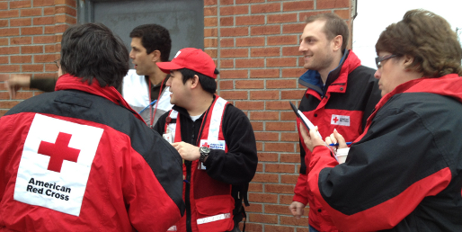
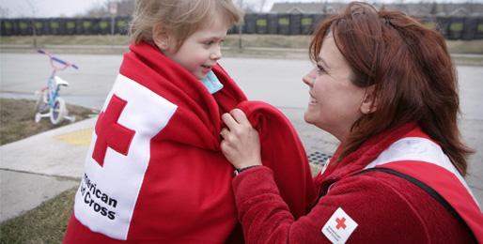
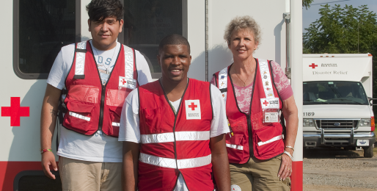
Red Cross wants its volunteers to stay engaged...
Notes:
Individuals not signing up to fulfill spots, don’t realize that this was what was

Slide 3
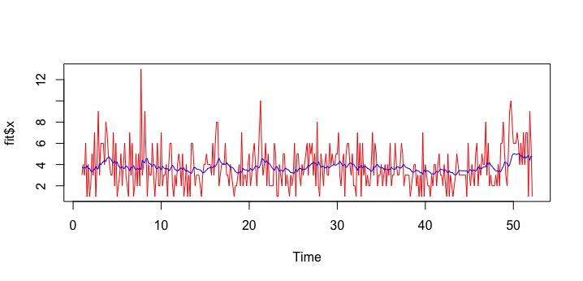
But they can’t predict exact # of incidents in a day...

Slide 4
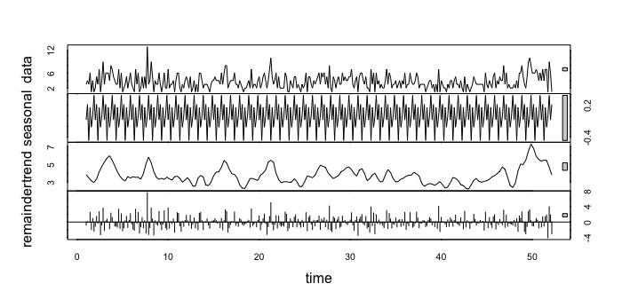
And there is no simple trend to follow...

Slide 5
1-13
Range of number of incidents from the Red Cross Chicago Chapter handles per day

Slide 6




Waiting volunteers are resources for doing good...
Sign up for a shift
Respond to phone in case of incident
Head to incident or continue to wait to another response

Slide 7

And Red Cross can use as many as possible...
Overstaffing is beneficial for the Red Cross to minimize distance and travel time to the incident.
Notes:
What is the least and most that you would need in one day
**FIND min and max of people that could be needed. There is no indicator really for what factors mean that it could be a big day in incidents
Even when work forecast is low; the work Red Cross does is too crucial to lean out volunteers
Capacity enables to select the best sort of volunteer for each situation
Overstaffing is beneficial
OVERSTAFF

Slide 8
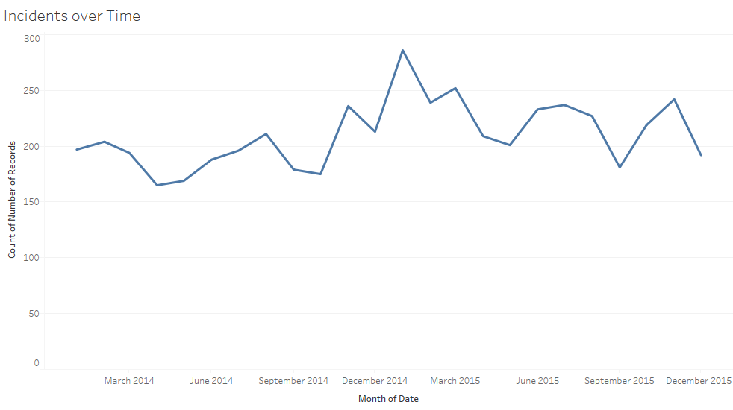
Red Cross’ need for volunteers fluctuates...

Slide 9
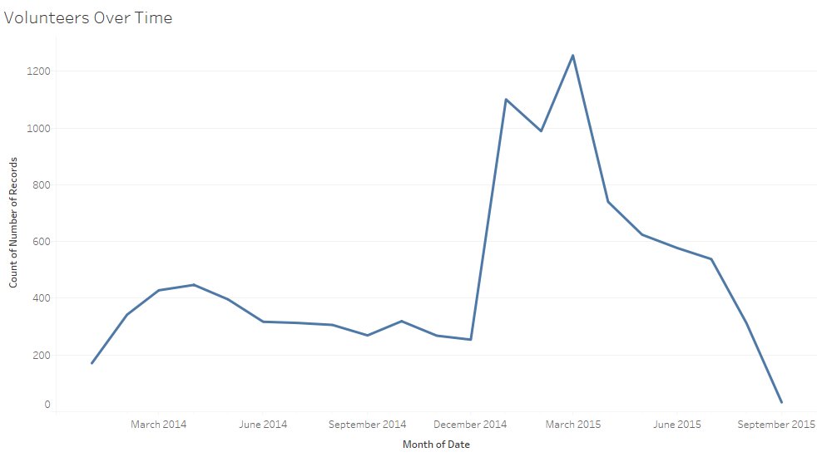
And volunteers can schedule themselves better...

Slide 10
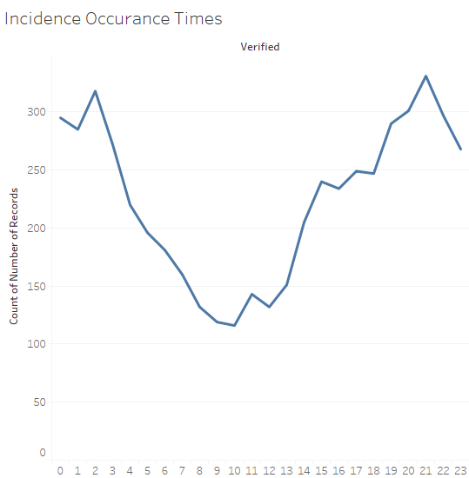
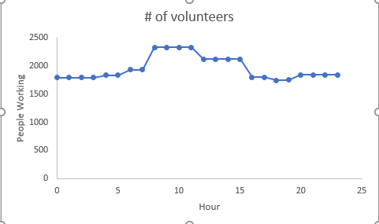
They’re not signing up when Red Cross needs them...

Slide 11
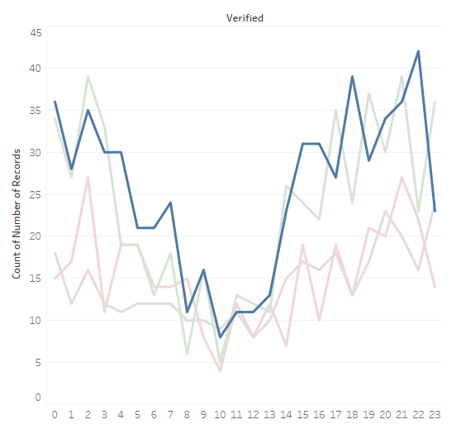
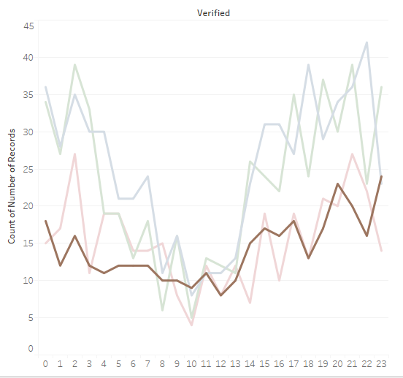
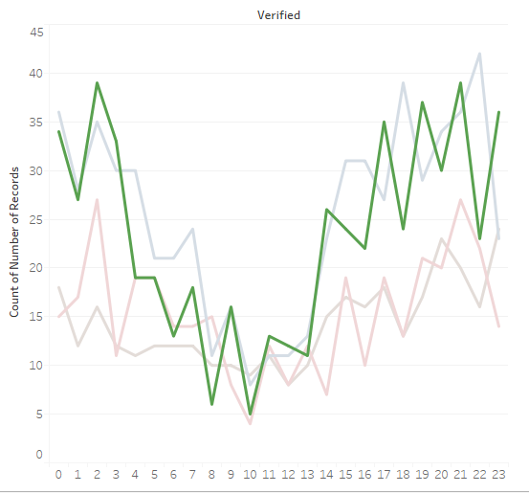
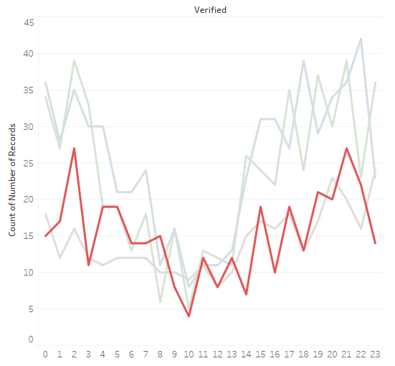
They’re not signing up when Red Cross needs them...
January
October
April
July
Notes:
MoNthS
Blue - january
Brown - october
Green - april
Red - july

Slide 12
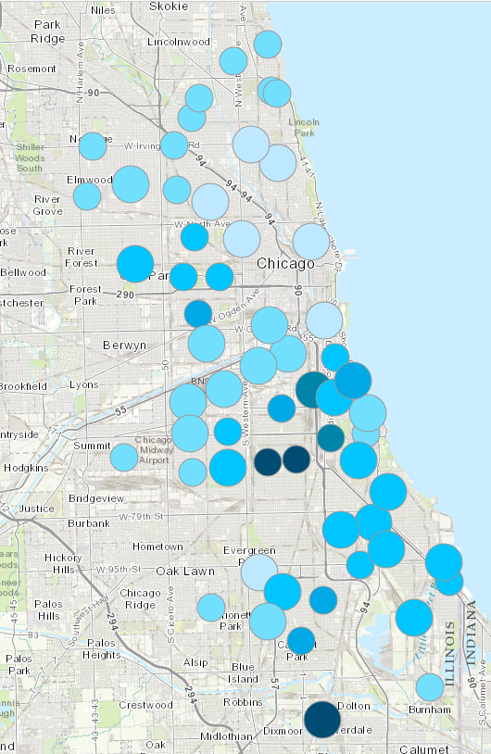
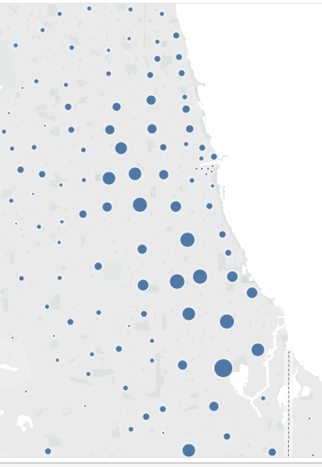
And they are not located where they are needed...

Slide 13

This story helps the volunteers understand that...
They should sign up for additional slots where other volunteers are less likely to sign up.
If they live in areas where there is high demand, then they can deliver high impact. They should volunteer with Red Cross during times of year when demand is higher.

